Slide 1
Chapter 8.7
t-Distribution
t-Distribution
In the previous section we discuss the utility of the Central Limit Theorem to infer a population mean or the difference between two population means.
These utility is based on the assumption that the population standard deviation is known.
However, in many experimental scenarios, knowledge of σ is not reasonable than knowledge of the population mean μ.
_
Often, an estimate of σ must be supplied by the same sample information that produced the sample average x.
As a result, a natural statistic to consider to deal with inferences on μ is

Slide 2
Chapter 8.7
t-Distribution
t-Distribution
If the sample size is large enough, say n ≥ 30, the distribution of T does not differ considerably from the standard normal.
However, for n < 30, the values of S² fluctuate considerably from sample to sample and the distribution of T deviates appreciably from that of a standard normal distribution.
In the case that sample size is small, it is useful to deal with the exact distribution of T.
In developing the sampling distribution of T, we shall assume that the random sample was selected from a normal population,
where

Slide 3
Chapter 8.7
t-Distribution
t-Distribution
Let Z be a standard normal random variable and V a chi-squared random variable with v degrees of freedom. If Z and V are independent, then the distribution of the random variable T, where
is given by the density function
This is known as the t-distribution with v degrees of freedom.

Slide 4
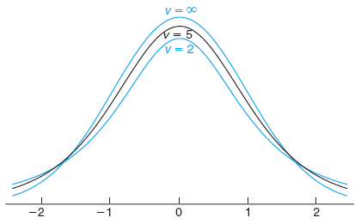
Chapter 8.7
t-Distribution
t-Distribution
Let X₁, X₂,..., X_{n} be independent random variables that are all normal with mean μ and standard deviation σ. Let
Then the random variable has a t-distribution with v = n – 1 degrees of freedom.
The shape of t-distribution curves for v = 2, 5, and ∞

Slide 5
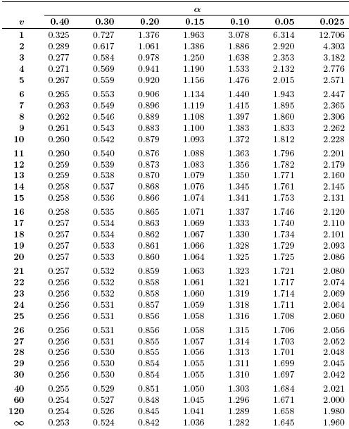
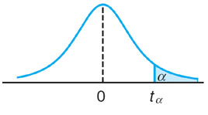
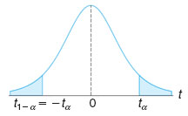
Chapter 8.7
t-Distribution
Table A.4 t-Distribution
It is customary to let t_{α} represent the t-value above which we find an area equal to α.
The t-distribution is symmetric about a mean of zero, that is, t_{1–α} = –t_{α}

Slide 6
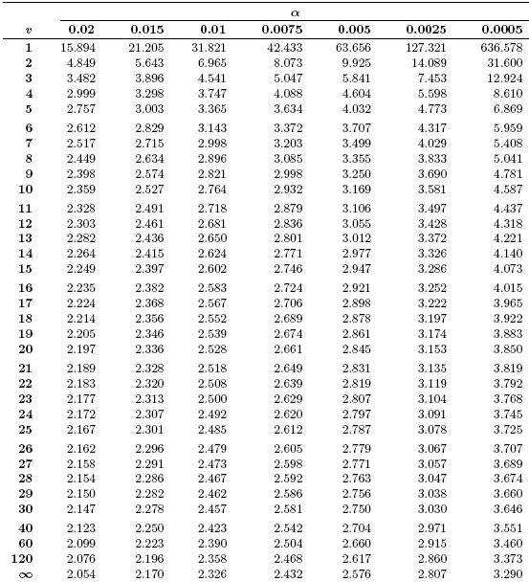
Chapter 8.7
t-Distribution
Table A.4 t-Distribution
A t-value that falls below –t_{0.025} or above t_{0.025} would tend to make us believe that either a very rare event has taken place or perhaps our assumption about μ is in error.
Should this happen, we shall make the latter decision and claim that our assumed value of μ is in error.

Slide 7
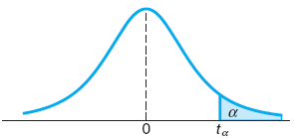
Chapter 8.7
t-Distribution
t-Distribution
The t-value with v = 14 degrees of freedom that leaves an area of 0.025 to the left, and therefore an area of 0.975 to the right, is
Find P(–t_{0.025} < T < t_{0.05}).

Slide 8
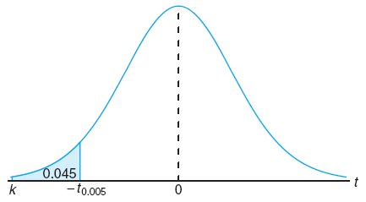
Chapter 8.7
t-Distribution
t-Distribution
Find k such that P(k < T < –1.761) = 0.045, for a random sample of size 15 selected from a normal distribution and
From t-Distribution Table, the value 1.761 corresponds to t_{0.05} for v = 14. So, t_{–0.05} = –1.761.

Slide 9
Chapter 8.7
t-Distribution
t-Distribution
A chemical engineer claims that the population mean yield of a certain batch process is 500 grams per millimeter of raw material. To check this claim he samples 25 batches each month. If the computed t-value falls between –t_{0.05} and t_{0.05}, he is satisfied with his claim.
What conclusion should he draw from a sample that has a mean x = 518 gr/mm and a sample standard deviation s = 40 gr? Assume the distribution of yields to be approximately normal.
_
From t-Distribution Table, the value 2.25 corresponds to α between 0.02 and 0.015.
This means, the probability of obtaining a mean of 518 gr/mm for a certain sample while the mean of population is 500 gr/mm is only approximately 2%.
It is more reasonable to assume that μ > 500.
Hence, the manufacturer is likely to conclude that the process produces a better product than he thought.

Slide 10
Chapter 8.8
F-Distribution
F-Distribution
If the t-distribution is motivated by the comparison between two sample means, the F-distribution finds enormous application in comparing sample variances.
The statistic F is defined to be the ratio of two independent chi-squared random variables, each divided by its number of degrees of freedom. Hence, we can write
where U and V are independent random variables having chi-squared distributions with v₁ and v₂ degrees of freedom, respectively.

Slide 11
Chapter 8.8
F-Distribution
F-Distribution
Let U and V be two independent random variables having chi-squared distributions with v₁ and v₂ degrees of freedom, respectively. Then the distribution of the random variable is given by the density
This is known as the F-distribution with v₁ and v₂ degrees of freedom.
Table A.6 in the reference gives values of f_{α} for α = 0.05 and α = 0.01 for various combinations of the degrees of freedom v₁ and v₂.
Table A.6 can also be used to find values of f_{0.95} and f_{0.99}. The theorem will be presented later.

Slide 12
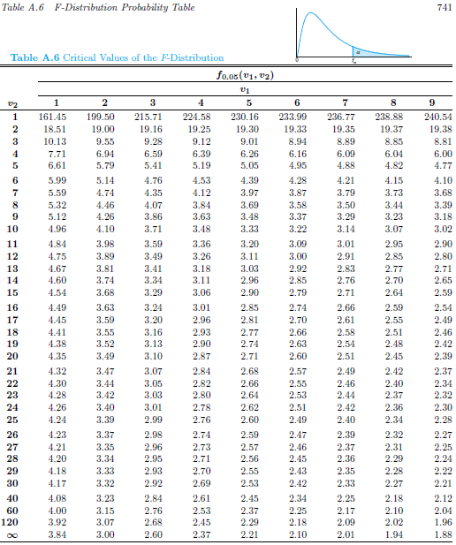
Table A.6 F-Distribution
Chapter 8.8
F-Distribution
α = 0.05

Slide 13
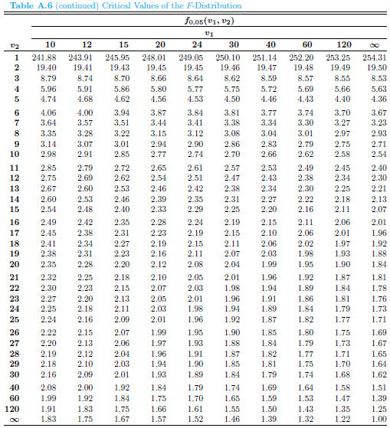
Table A.6 F-Distribution
Chapter 8.8
F-Distribution
α = 0.05

Slide 14
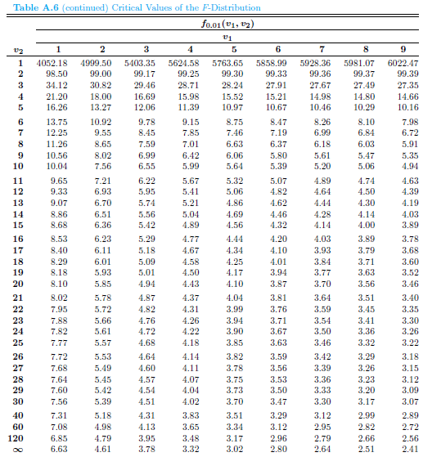
Table A.6 F-Distribution
Chapter 8.8
F-Distribution
α = 0.01

Slide 15
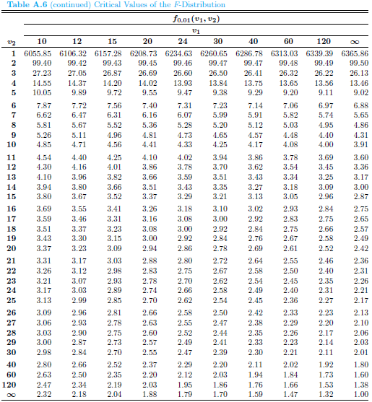
Table A.6 F-Distribution
Chapter 8.8
F-Distribution
α = 0.01

Slide 16
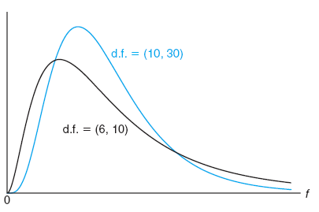
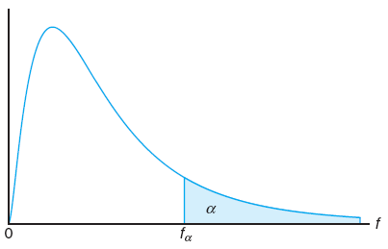
Chapter 8.8
F-Distribution
F-Distribution
Typical F-distribution
Tabulated values of the F-distribution
Writing f_{α}(v₁, v₂) for f_{α} with v₁ and v₂ degrees of freedom, we obtain

Slide 17
Chapter 8.8
F-Distribution
F-Distribution with Two Sample Variances
If and are the variances of independent random samples of size n₁ and n₂ taken from normal populations with variances and , respectively, then
has an F-distribution with v₁ = n₁ – 1 and v₂ = n₂ – 1 degrees of freedom.

Slide 18
Probability and Statistics
Homework 10A
A maker of a famous chocolate candies claims that their average calorie is 5 cal/g with a standard deviation of 1.2 cal/g. In a random sample of 8 candies of this famous brand, the calorie content was found to be 6, 7, 7, 3, 4, 5, 4, and 2 cal/g. Would you agree with the claim? Use Chi-squared distribution and assume a normal distribution. (Wal8.852 ep.283)
A small cleaning service company obtains a contract proposal from a customer owning an office tower with 100 rooms. The company has only 5 workers. It needs to determine its profit margin by first finding out the time required by the workers to finish cleaning 100 rooms. The first estimation is that the workers would need 5.5 hours to clean the 100 rooms.
The company starts a probation period for two week, while collecting data so that it can later charge the customer correctly. The data collected by the company can be seen on th next table.
After collecting this data, the company wants to determine if the first estimation of 5.5 hours to finish cleaning 100 rooms was reasonable. If the computed t-value falls between –t_{0.025} and t_{0.025}, the company would be satisfied and will stay with its first estimation. What is your opinion? (Int.Rndvz ep.283)
Time to clean 100 rooms
5.5
7
6.4
4.5
3.9
7.1
5.6
5.8
7.8
4.6
4.5
5.5

